Slide 1
UnitedHealthcare Diabetes Care & You
Presented by Johnathan Glover, LPN – Clinical Practice Consultant
Notes:
Welcome! I’m a Clinical Practice Consultant with UnitedHealthcare. My name is John. I have spent years helping diabetics and those diagnosed with pre-diabetes control their A1c levels through a healthy diet. My information comes from personal experience and success from working with patients, as well as information websites such as American Diabetes Association, National Institutes of Health, and Centers for Disease Control and Prevention.

Slide 2
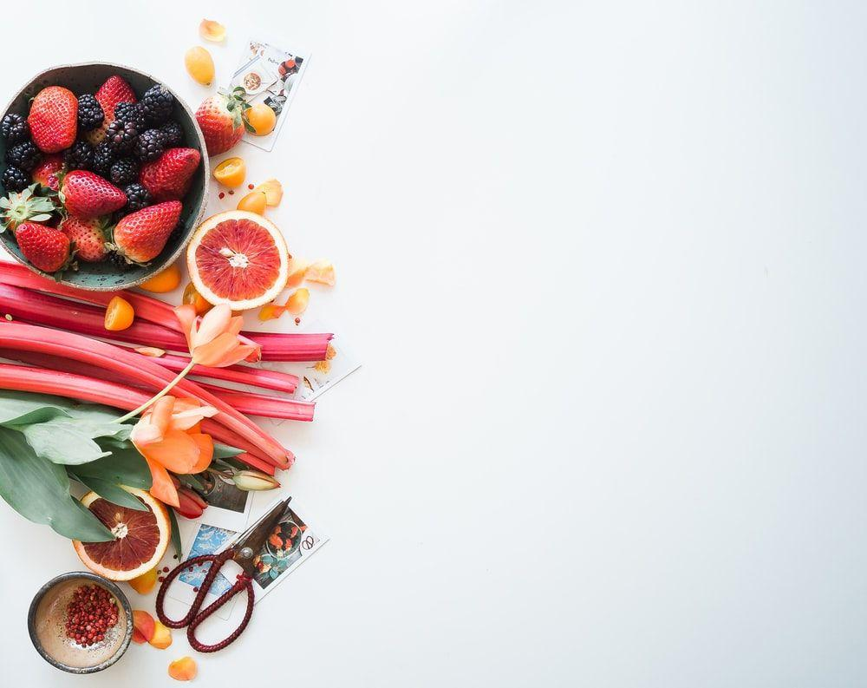
Why Diet Matters
Notes:
We’re going to go over some basic information on why your diet matters and how it contributes to managing your diabetes.

Slide 3
Why Diet Matters
The foods you eat have a direct impact on your blood glucose levels
Notes:
This first one is obvious, the food you eat directly impacts your blood glucose level. This is important to remember though as you’re preparing meals. Remembering what you put in, is what you get out can be motivating to skip unhealthy foods or beverages.

Slide 4
Why Diet Matters
The foods you eat have a direct impact on your blood glucose levels
Managing your blood glucose level is key to diabetes management
Notes:
It is key to manage your glucose level long-term. High glucose levels over time can cause damage to blood vessels and organs.

Slide 5
Why Diet Matters
The foods you eat have a direct impact on your blood glucose levels
Managing your blood glucose level is key to diabetes management
Carbohydrates are converted into glucose (a type of sugar) during digestion
Notes:
Carbohydrates are converted to glucose while being digested. This is why we’ll go over carb-counting.

Slide 6
Why Diet Matters
The foods you eat have a direct impact on your blood glucose levels
Managing your blood glucose level is key to diabetes management
Carbohydrates are converted into glucose (a type of sugar) during digestion
Type 2 diabetes occurs when your body cannot make enough insulin or cannot use the insulin it makes
Notes:
Over time, pushing your body to produce more insulin because of high glucose levels can cause it to produce less insulin. You can also start to become resistant to insulin. Type 2 diabetes can be because of one of these issues or both.

Slide 7
Why Diet Matters
The foods you eat have a direct impact on your blood glucose levels
Managing your blood glucose level is key to diabetes management
Carbohydrates are converted into glucose (a type of sugar) during digestion
Type 2 diabetes occurs when your body cannot make enough insulin or cannot use the insulin it makes
Insulin helps glucose enter the cells in your body so it can be used for energy
Notes:
Insulin is important because it reduces the amount of glucose in your blood. A decrease in insulin production and resistance to the insulin you make are why you have higher than normal glucose levels.

Slide 8
Why Diet Matters
The foods you eat have a direct impact on your blood glucose levels
Managing your blood glucose level is key to diabetes management
Carbohydrates are converted into glucose (a type of sugar) during digestion
Type 2 diabetes occurs when your body cannot make enough insulin or cannot use the insulin it makes
Insulin helps glucose enter the cells in your body so it can be used for energy
When blood glucose levels are high over a long period of time it causes damage to parts of your body such as eyes, kidneys, nerves, and blood vessels
Notes:
Damage to your blood vessels and organs doesn’t happen rapidly. It is a slow process that’s irreversible once the damage starts to take place. High glucose levels over time damage your blood vessels and organs enough to where you start have vision problems, chronic kidney disease, heart disease, liver damage, and problems with nerves like peripheral neuropathy.

Slide 9
Why Diet Matters
The foods you eat have a direct impact on your blood glucose levels
Managing your blood glucose level is key to diabetes management
Carbohydrates are converted into glucose (a type of sugar) during digestion
Type 2 diabetes occurs when your body cannot make enough insulin or cannot use the insulin it makes
Insulin helps glucose enter the cells in your body so it can be used for energy
When blood glucose levels are high over a long period of time it causes damage to parts of your body such as eyes, kidneys, nerves, and blood vessels
Understanding the carbs in the foods you eat will help you manage your diabetes (simple vs Complex)
Notes:
Understanding carbohydrates and how they add to your nutrition will help you make healthy choices.

Slide 10
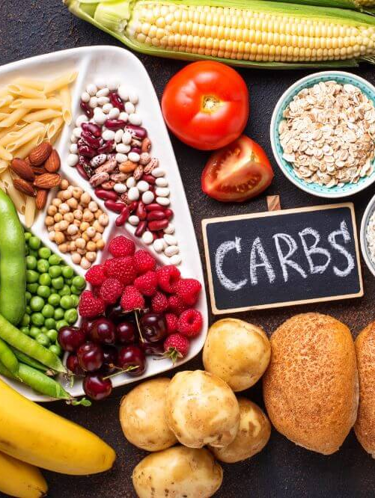
Carbohydrates
If you ever question whether something is a healthy carb, stay away from anything processed or with added sugar.
Just because something is a healthy carb doesn’t mean it’s good for you. Always try to fill up on non-starchy vegetables for your carbohydrate count and add another complex carb to fill in the gap on your carb count for each meal.
Notes:
Carbohydrates come from things like starches and grains, fruit, milk, and non-starchy vegetables. Some of these choices are healthier than the others.

Slide 11
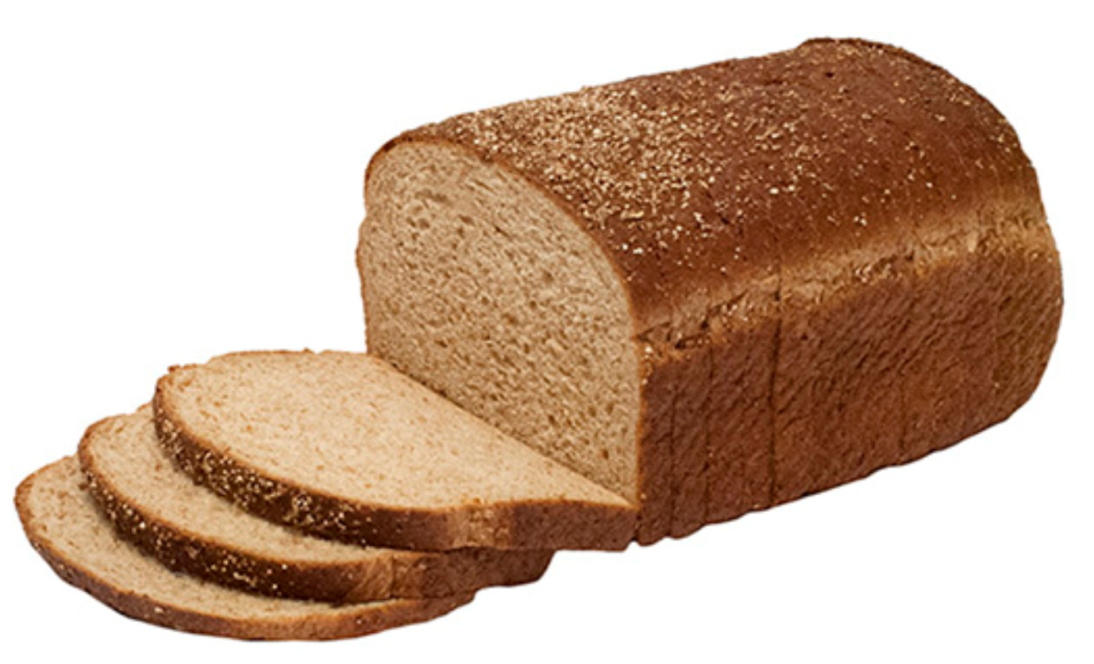
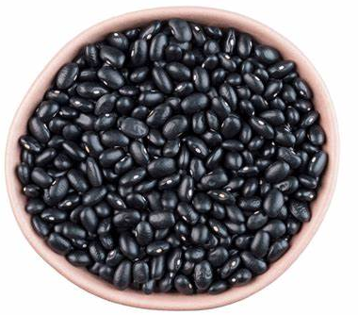
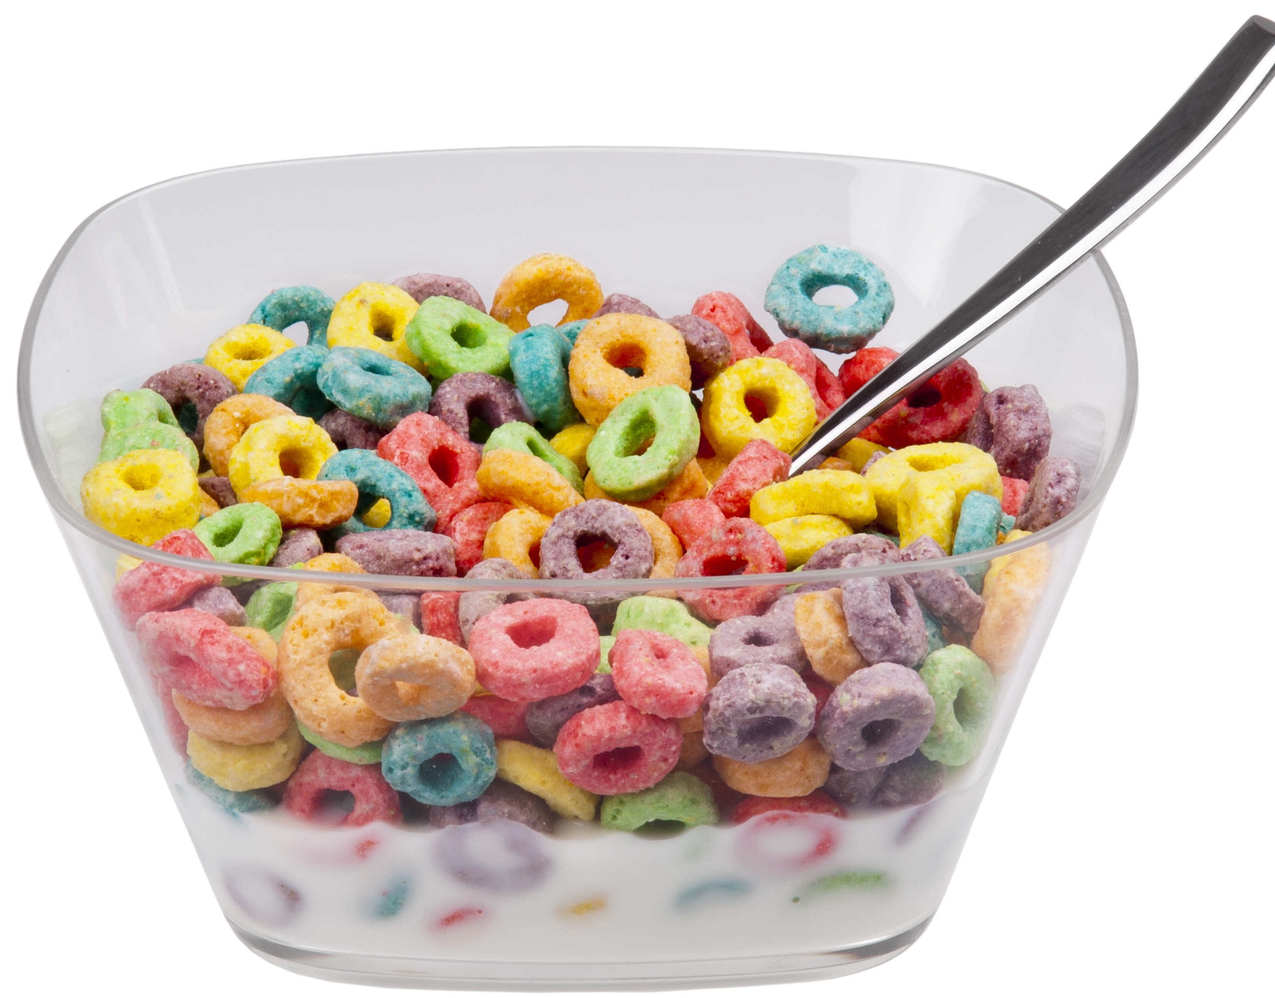
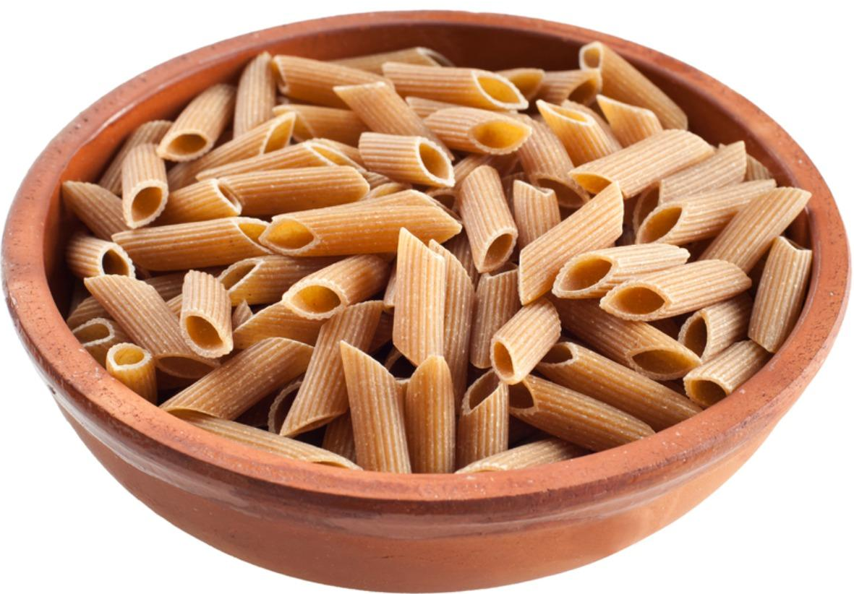
Complex Carbohydrates
VS.
Simple Carbohydrates
Harder for your body to process
Digest slowly
More nutrients and are more filling
Include vegetables, brown rice, whole wheat bread, oats, black beans.
Easier for your body to process
Digest quickly
Fruit and milk are ok to have in moderation, but others, such as sugary foods and drinks or processed foods like white bread are not.
Notes:
Looking at this chart, you would say complex carbs are obviously the better choice. They seem healthier. That’s not true however, simple carbohydrates also include fruit and milk. Using both complex and simple carbs together will help you form a balanced, healthy diet.

Slide 12
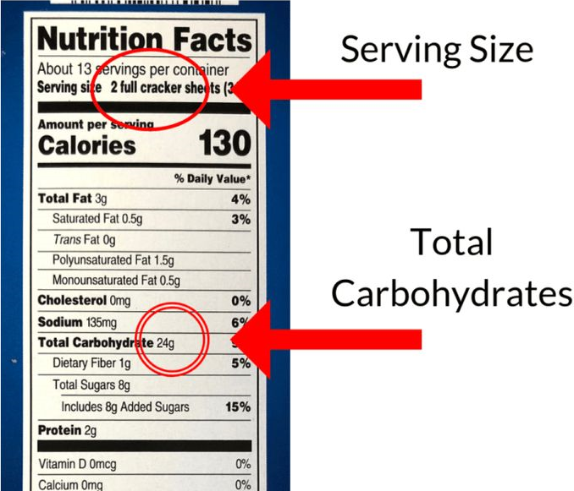
Count EVERYTHING!
Fill up on healthy carbohydrate choices, not starches and grains.
Look at the “Total Carbohydrates” area on nutrition labels, then decide how many servings you will eat.
Multiply the servings by the number of carbohydrates on the label.
Notes:
Carb counting consists of looking at the nutrition label and adding up the total carbohydrates for each serving of each food you’re eating for your meal. No calculations of subtracting fiber from carbs needed. Just times the total carbohydrates by the number of servings you’re eating.

Slide 13
Carb Counting
Women should eat 30 – 45 grams per meal
Men should eat 50 – 60 grams per meal
Snacks should be no more than 15 grams of carbs
Notes:
Here are the carb ranges for women and men. For maintaining weight, stay closer to the high end of the range. To lose weight, stay closer to the low end of the range.

Slide 14
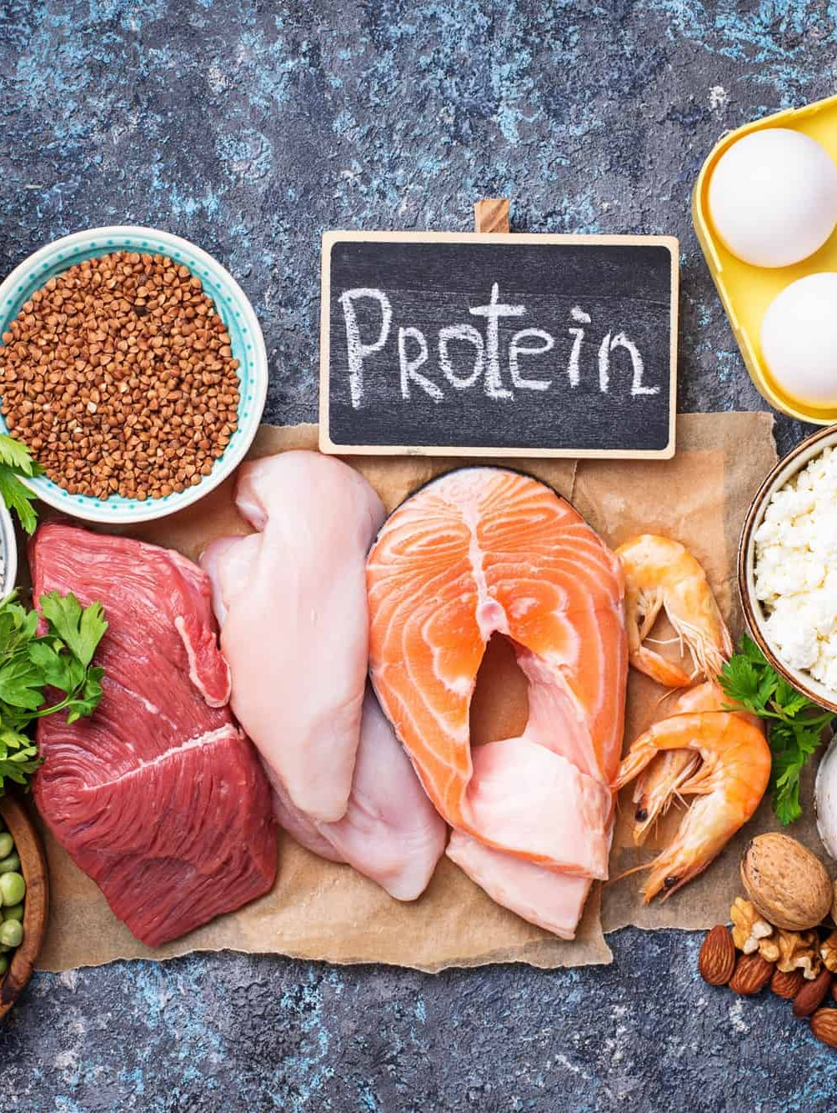
Protein
Always eat protein with every meal and snack.
Protein slows the absorption of carbohydrates into your system.
Cook your protein any way you want as long as it isn’t fried.
Have at least 3 oz (size of a deck of cards) on your plate.
Servings should be around 20 grams of protein per meal.
Notes:
Another very important piece of a healthy diabetic diet is protein. You must have protein with every meal and every snack. Protein slows down the absorption of carbohydrates into your system. Without it, you would see abnormal glucose levels. You need at least 20 grams of protein with every meal. Snacks are different, but we’ll look at that in one of the slides coming up. 3 oz of protein should get you pretty close to 20 grams; however, it doesn’t hurt to have more on your plate to make sure you get at least 20 grams.

Slide 15
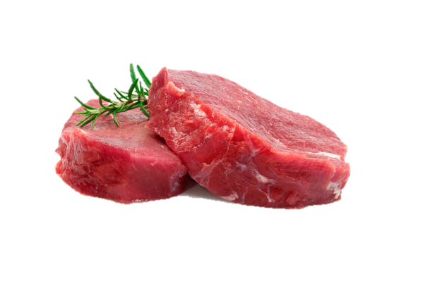
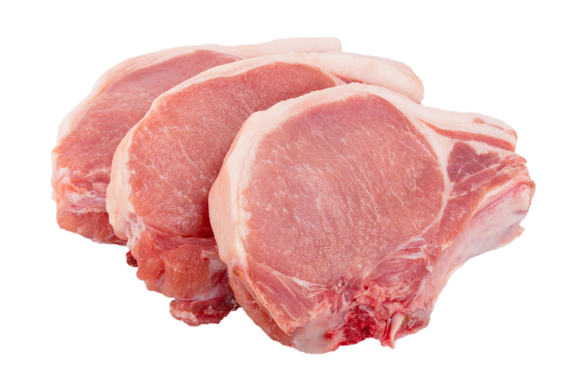
Healthy Proteins
VS.
Less Healthy Proteins
Healthy proteins are chicken, turkey, and fish.
Avoid red meat and pork due to fat and salt.
Notes:
Try to stick to healthy proteins. These are chicken, turkey, and fish. Limit your intake of red meat and pork due to fat and salt content. You can cook your protein any way you want as long you don’t fry it. Bake it, broil it, boil it, grill it, air fry it, or cook it in a skillet.

Slide 16
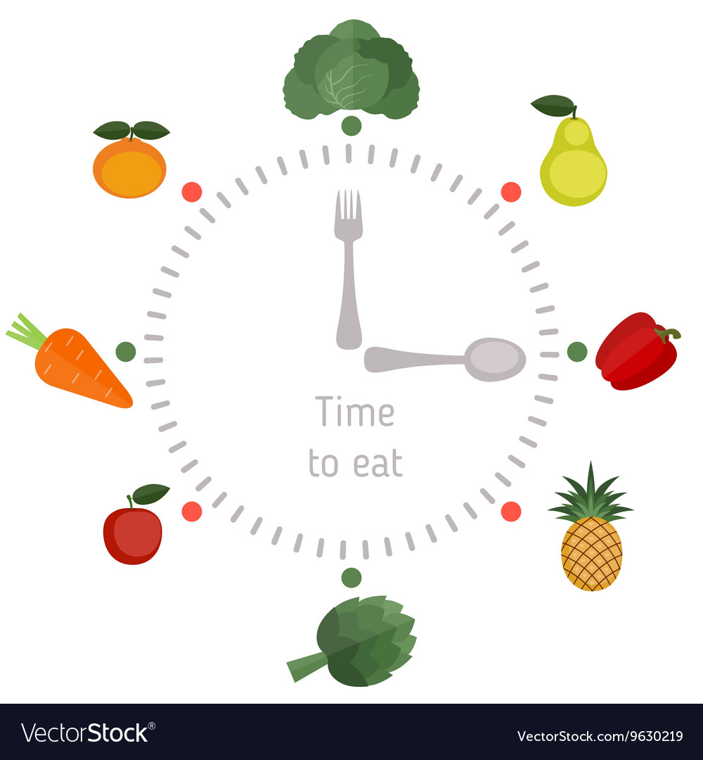
Eat Consistently
The goal is 3 meals (6 small meals) per day.
Try to stay within the same time frames per meal every day.
Meal prepping and planning is your best friend when it comes to staying on track.
Notes:
If we look at the diabetes diet in three important instructions to follow. Carb counting would be one. Protein would be two. Eating consistently would be considered the third important instruction to follow. Eating consistently helps your body have enough carbs throughout the day to perform its normal processes. Eating consistently helps maintain a good metabolism. Your body can store glucose for later use and, when not eating consistently, storing glucose increases. You can see abnormal glucose spikes and lows throughout the day when not eating consistently.

Slide 17
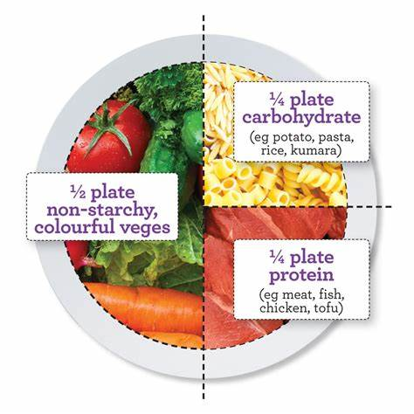
Meal Portions
Fruit Portions
Most of your carbs for meals should come from healthy vegetables, a small amount can come from starches and grains to help get to your carb count.
Fruit no more than twice per day, preferably once, and should be counted as a snack. Only get small fruits, the difference between a small and large apple is about 15 grams of carbs.
Notes:
When forming your plate for meals, it should look like the above picture. Half of your plate should be non-starchy vegetables, a fourth should be your protein, and the other fourth can be a starch or grain. However, it’s always best to fill up on only non-starchy vegetables and protein, but this can be hard to do and stay within your carb range. We’ll go over examples of non-starchy vegetables and carb amounts in another slide. Fruit and milk are good things to add to your daily diet. Fruit contains vitamins and fiber. Milk contains things like Vitamin D and calcium. Milk and fruit also contain a high amount of carbs. We’ll look closer at fruit and milk on another slide, but the important thing to remember is to have them in moderation.

Slide 18
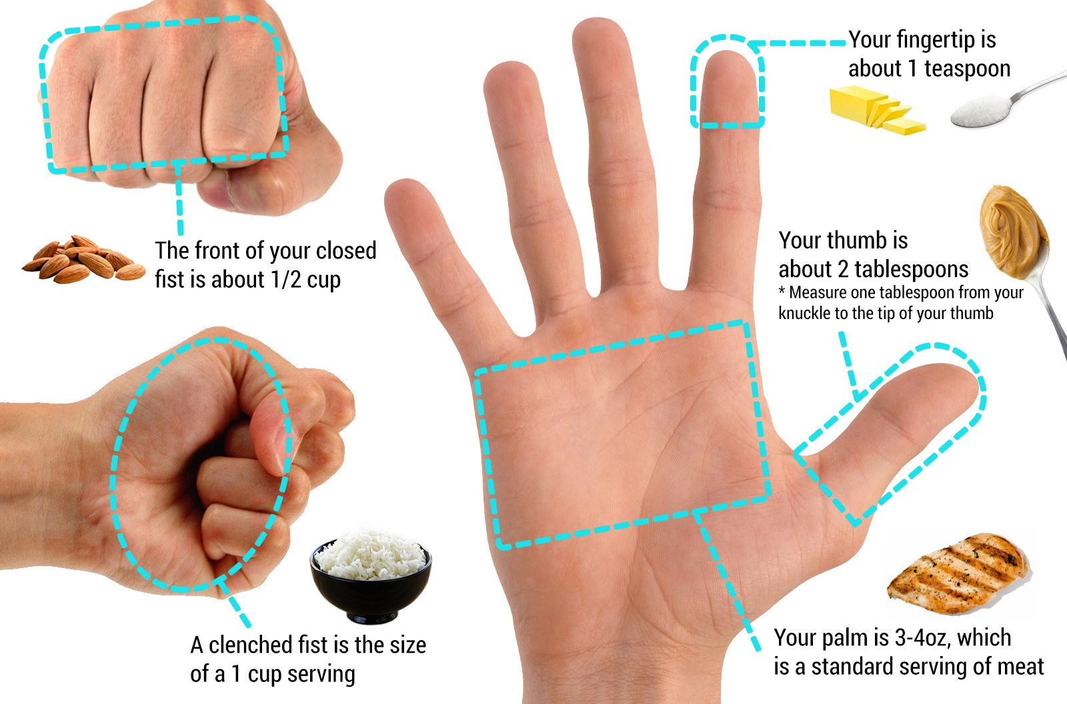
If there is no way to measure, use your hand!
Notes:
It’s always better to use a measuring spoon and cup, but when you’re out and don’t have those things, this will help. These measurements aren’t exact, and everyone’s hand size is different, but this will get you close to the measurement you’re looking for.

Slide 19
Snacks
No more than two snacks per day.
Only eat snacks when you’re hungry and to prevent low blood sugars.
Keep track of your blood sugar, if checking it, and try to time snacks when your blood sugar tends to get low.
Notes:
Snacks should be viewed as tool to help with hunger and to prevent low blood sugars. They aren’t meant to be added to your daily diet just to have them. Try to time snacks between meals for hunger. When experiencing low glucose levels, time snacks to prevent them. Example, eat a snack before bed if glucose levels drop while sleepings or eat a snack before exercising if experiencing low glucose levels during or after exercise.

Slide 20
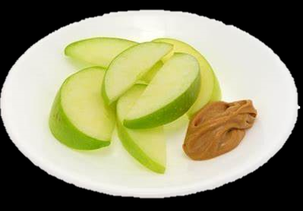
Healthy Snacks
Eat healthy protein with every meal and snack.
Snacks should be 15 grams of carbs and at least 5 grams of protein.
Ideas: Small apple sliced with peanut butter, Rice cakes with peanut butter, one slice of whole-wheat bread and cheese, check protein bars for a healthy option.
Notes:
Snacks should contain 15 grams of carbohydrates and at least 5 grams of protein. See the above suggestions for healthy snack ideas. You can look in your local grocery store for a protein bar solution to have something easier to carry around. If looking for a protein bar, please get one as close to 15 grams of carbohydrates as possible, but you can have more than 5 grams of protein.

Slide 21
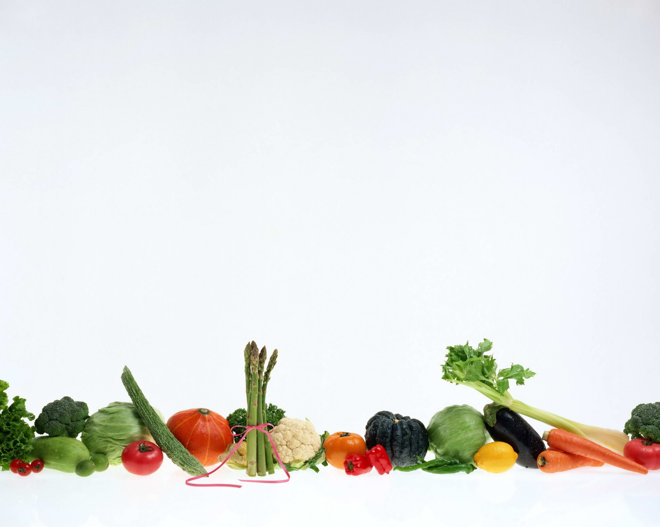
Vegetables
Half of your plate should be vegetables per meal.
1 cup cooked is 10 grams of carbs.
1 cup raw is 5 grams of carbs.
Asparagus
Broccoli
Spinach
Brussel Sprouts
Green Beans
Celery
Tomatoes
Cabbage
Turnips
Cauliflower
Mushrooms
Cucumber
Onions
Eggplant
Notes:
This is not a complete list of non-starchy vegetables. Note that the carbohydrate count goes up when cooking your vegetables. If one vegetable gets boring, try mixing some of them together, changing seasoning, or changing the way you cook your vegetables.

Slide 22
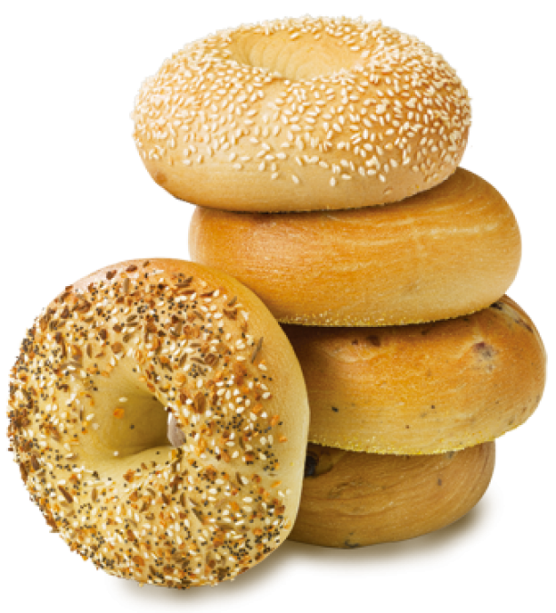
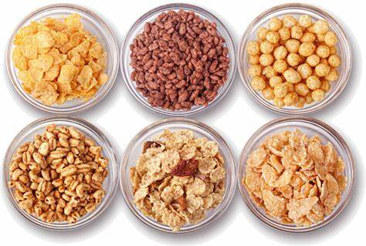
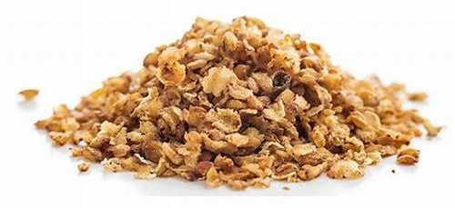
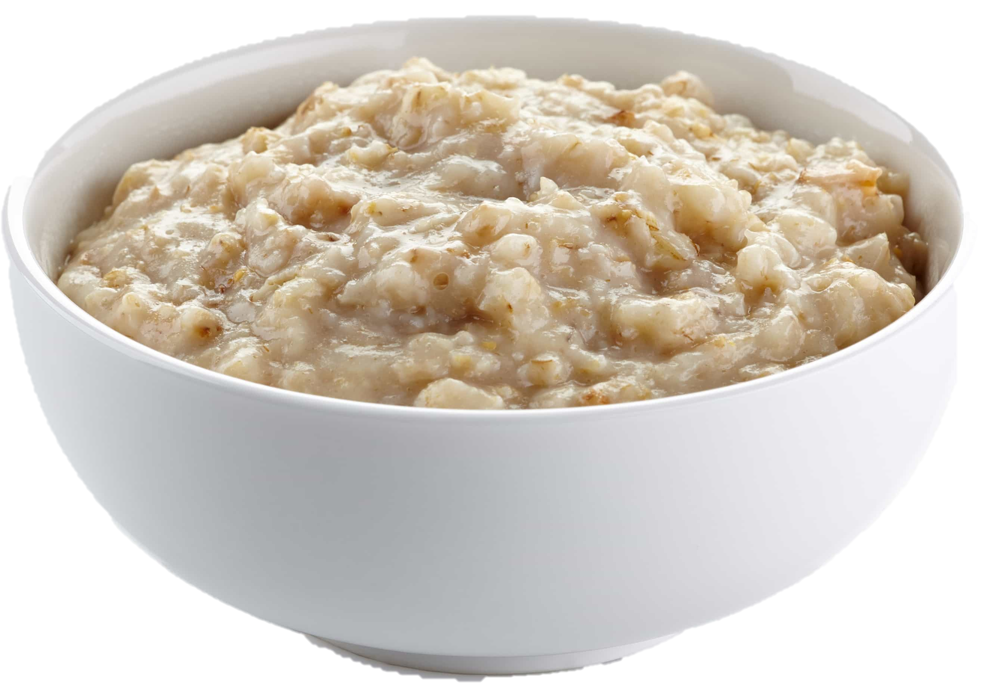
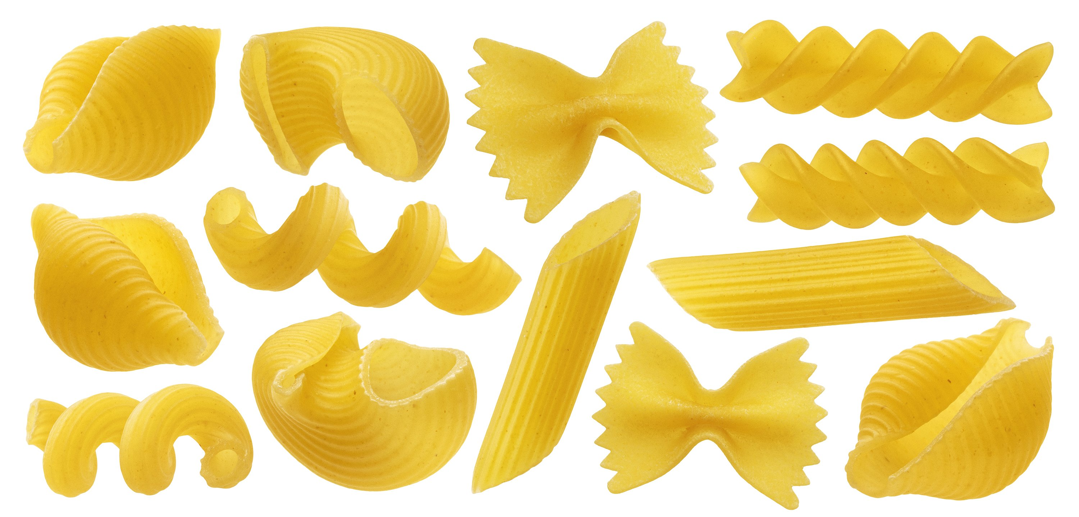
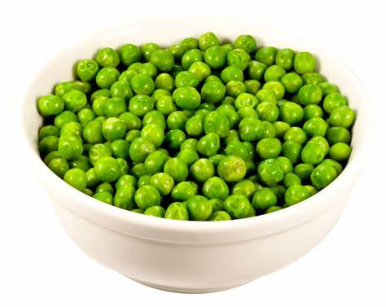
Starches & Grains High in Carbohydrates
Bagels
¼ = 15 grams
Bread
1 slice = 15 grams
Hotdog/Hamburger Bun
½ = 15 grams
Oatmeal
½ cup = 15 grams
Unsweetened Cereal
¾ cup = 15 grams
Granola
¼ cup = 15 grams
Pasta
1/3 cup = 15 grams
Peas
½ cup = 15 grams
Corn
½ cup or one large cob = 15 grams
Notes:
Starches and grains are high in carbohydrates. A little bit added to meals can help you with getting into your carbohydrate range. Things like a slice of bread can be used by itself to get about 15 carbohydrates for your snacks. This makes it easy to put something together quickly for snacks or make something more portable. Be careful of things like peas and corn. These often are mistaken for something healthy to eat in large quantities, when you are actually eating too man carbs. Cereal is another sneaky food that pushes you way out of your carbohydrate range. The small amounts that add to 30 or 45 grams of carbohydrates, along with milk that’s high in carbohydrates by itself, make it easy to see how you are most likely eating double or triple your carbohydrate range in one bowl.

Slide 23
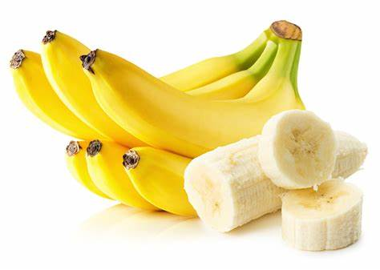
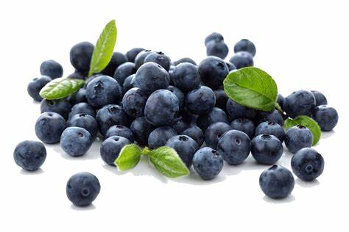
Fruits & Milk High in Carbohydrates
Apple
Small = 15 grams
Banana
½ = 15 grams
Whole, Skim, 2% Milk
1 cup = 15 grams
Blueberries
¾ cup = 15 grams
Orange
Small = 15 grams
Notes:
Fruit and milk are often used as a substitute to some breakfast foods or are even added to breakfast. This is fine, just be aware of how much fruit and milk are being added to your meals. Just one cup of milk and a small amount of fruit equal 30 grams of carbohydrates.

Slide 24
Fats and Oils
Use sparingly
These do slow down rising blood sugar, but are high in fat
Notes:
Fats and oils should only be used sparingly, do not use them as a way of dropping glucose levels. Only use enough to make whatever you’re using to cook your food in non-stick.

Slide 25
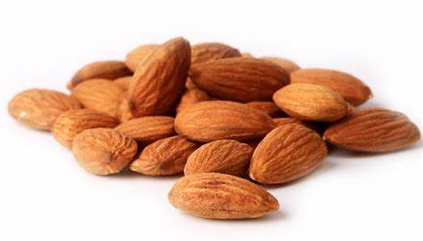
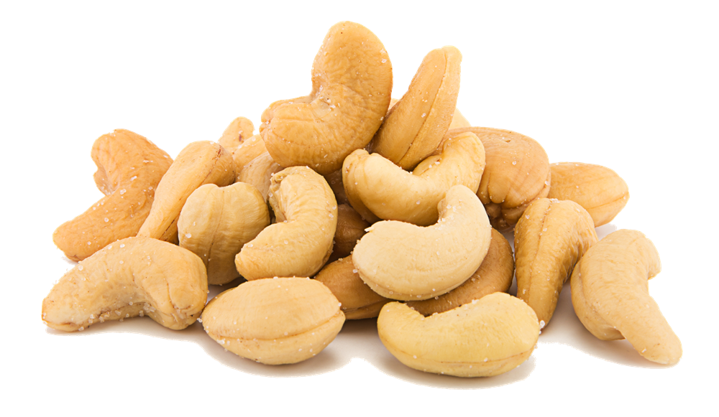
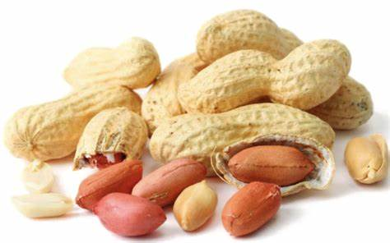
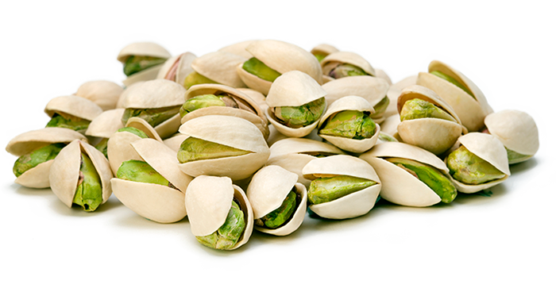
Fats & Oils * Suggested Serving Sizes (each 5 grams of fat)
Cream Half & Half
2 tbsp
Coconut Oil
1 tsp
Vegetable Oil
1 tbsp
Mayonnaise Regular
1 tsp
Mayonnaise Reduced Fat
1 tbsp
Butter Stick
1 tsp
Butter Whipped
2 tsp
Margarine Low Fat
1 tsp
Sour Cream Regular
2 tbsp
Sour Cream Reduced Fat
3 tbsp
Almonds
6 nuts
Cashews
6 nuts
Peanuts
10 nuts
Pistachios
16 nuts
Notes:
These are foods high in fat. Notice peanuts are on the slide when we discussed peanut butter being used for snacks. Peanut butter can be used for snacks because you only need about one and a half tablespoons to get 5 grams of protein. Talk to your doctor about how much fat you should have in your diet.

Slide 26
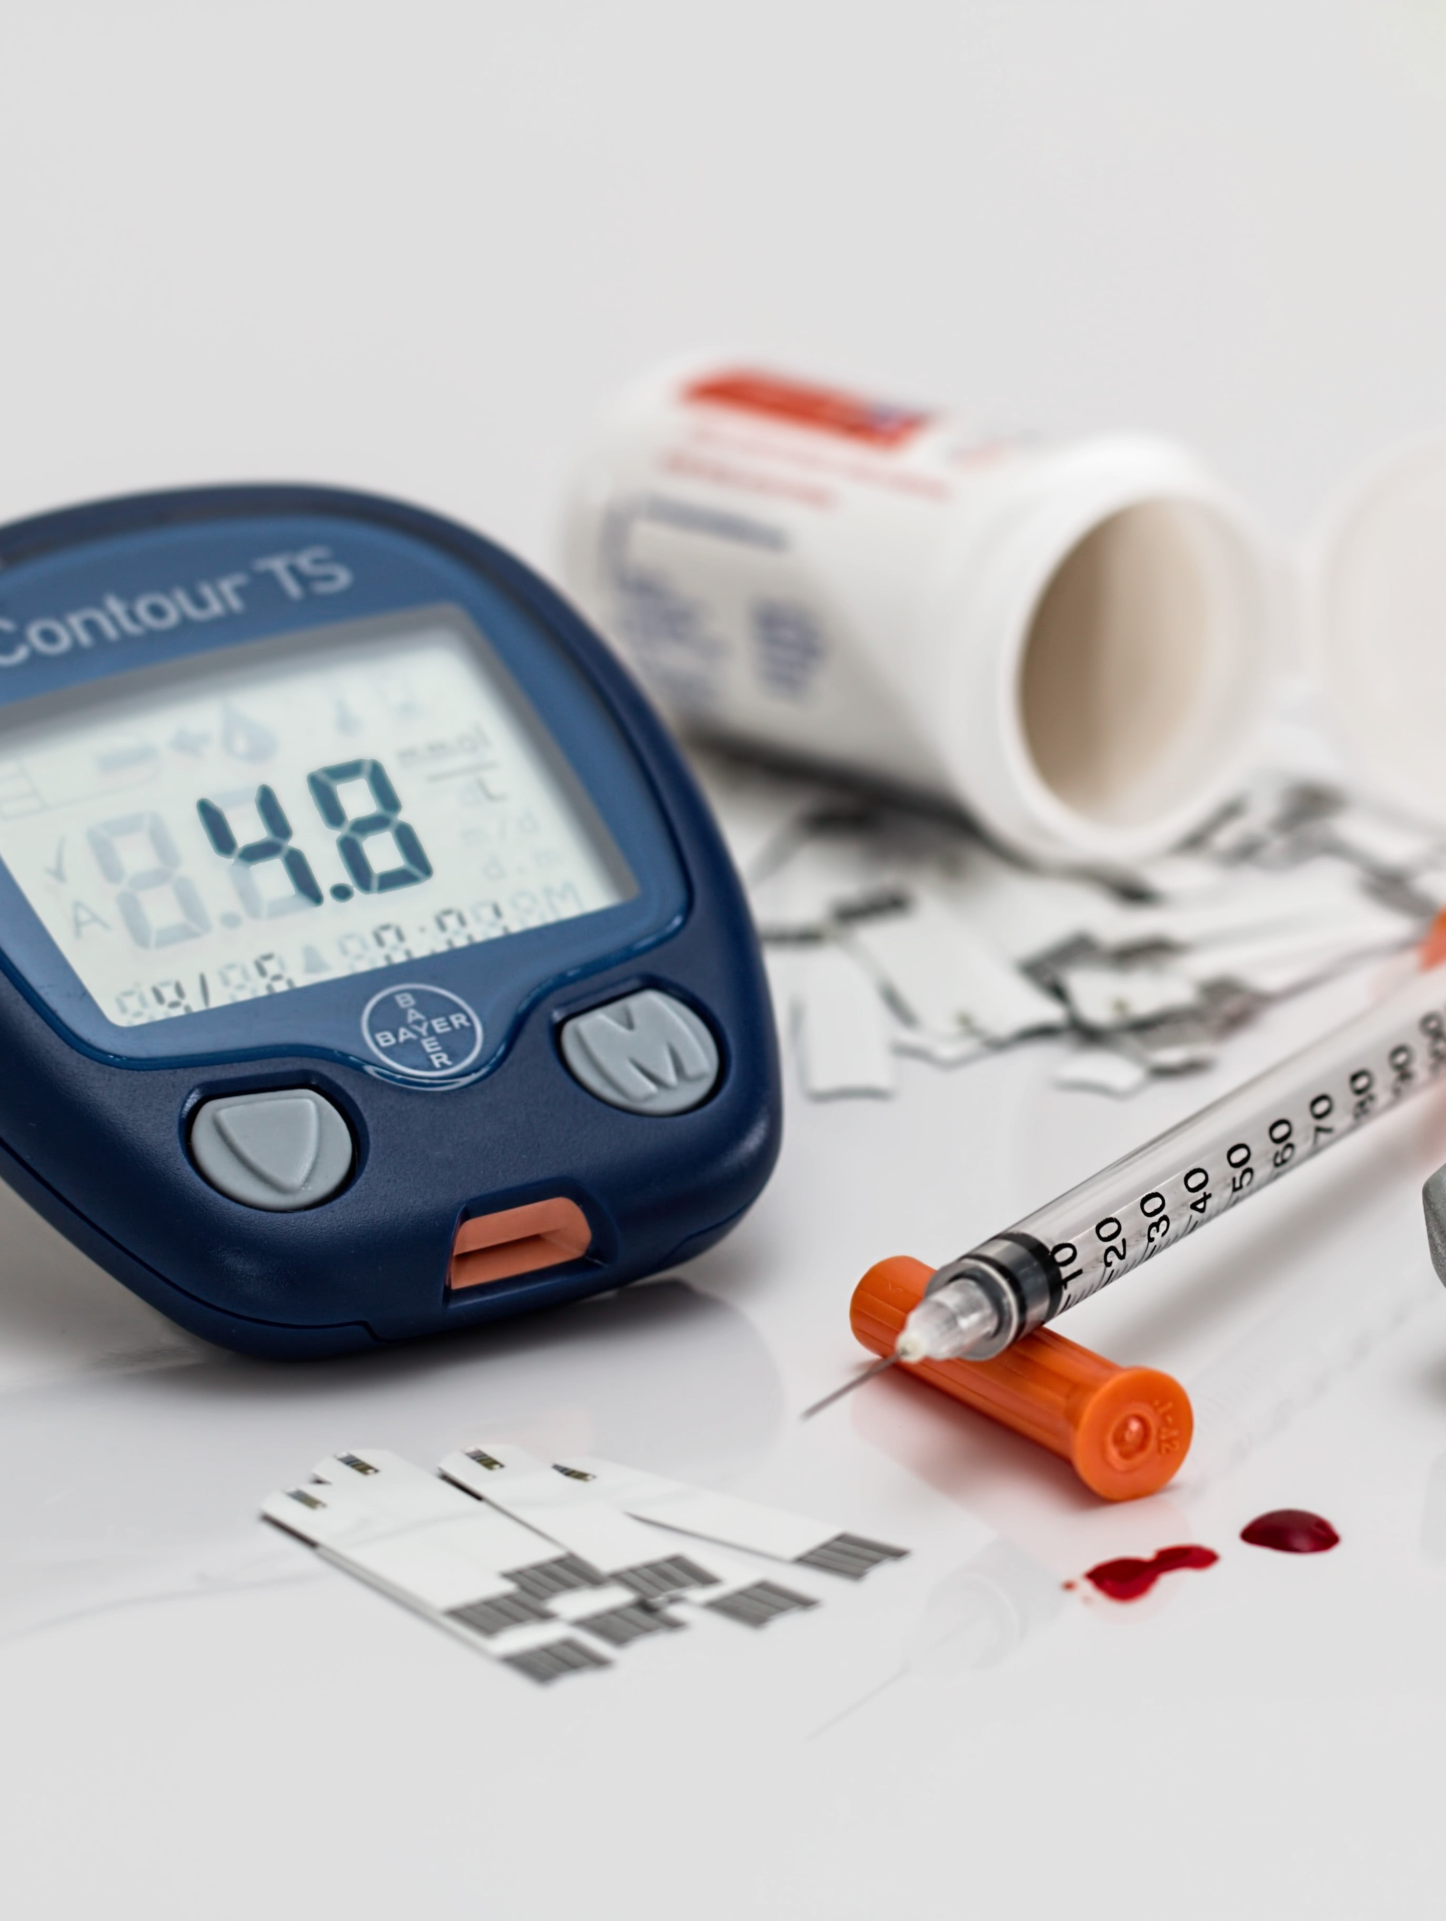
Blood Sugar Tracking
Notes:
That’s it for the diet portion of this education. Next, we’ll go over tracking your glucose levels, A1c tracking, and signs/symptoms of hyper/hypoglycemia.

Slide 27
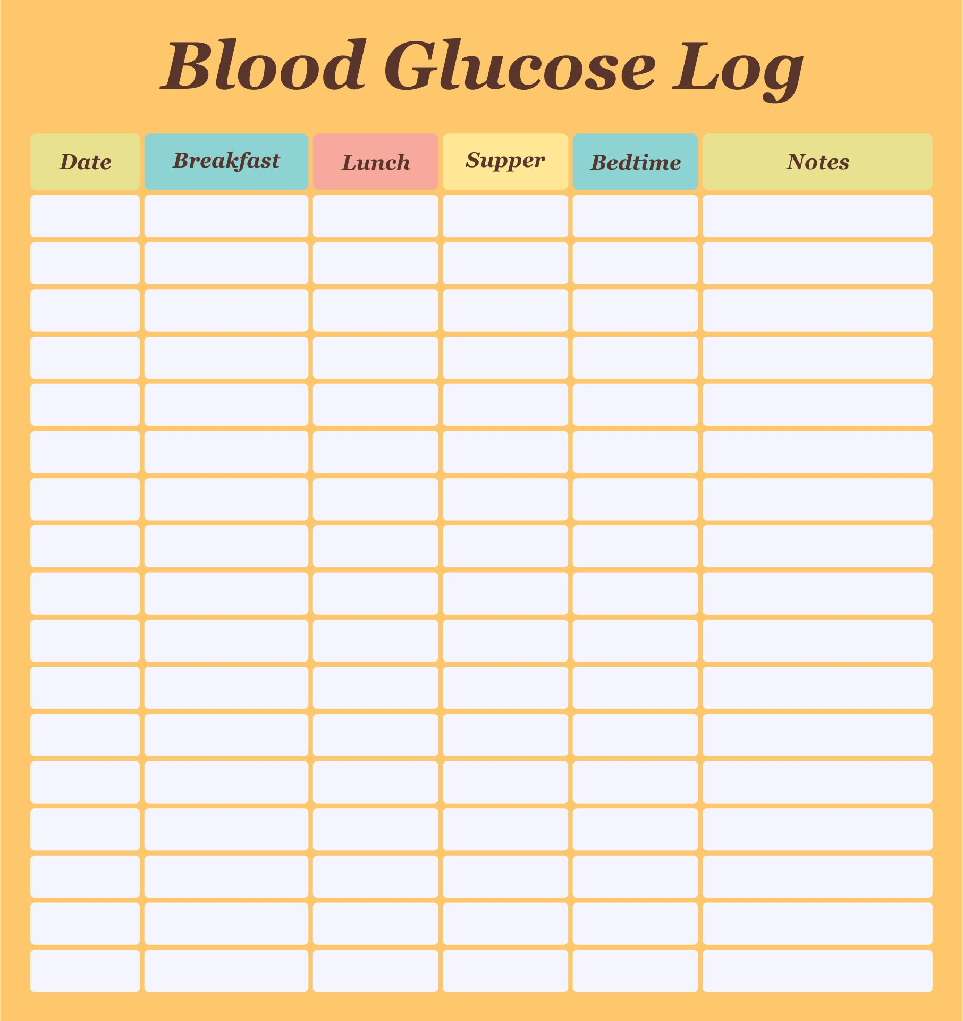
Blood Sugar Tracking
It is important that you follow your doctor’s suggestions. Always keep a logbook of your sugars and bring it to every appointment.
Notes:
It’s important to keep an up to date and accurate blood glucose log for your doctor to look at during every appointment. When logging your glucose levels, put the day, time, glucose level, last time you ate before checking your glucose level, and a brief explanation of what you ate.

Slide 28
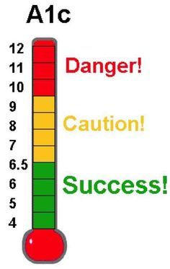
Blood Sugar Tracking
It is important that you follow your doctor’s suggestions. Always keep a logbook of your sugars and bring it to every appointment.
Checking your A1C completes the picture with your logbook to see how your sugars have been running for the last 3-months. This is important to see how they were running when you didn’t check, it gives an average.
Notes:
A1c results give your doctor an average glucose level for the last 3 months. The A1c level and glucose log work together to help complete the picture of how well you’ve been managing your diabetes. Your glucose log shows your actual glucose levels and if your A1c isn’t at a place it needs to be or trending in the right direction, your doctor can review your glucose log to see why. Likewise, if your A1c is at a good level, your doctor may review your glucose log to see why there is a positive change. Please take your glucose log to every appointment and never skip your A1c lab appointments.

Slide 29
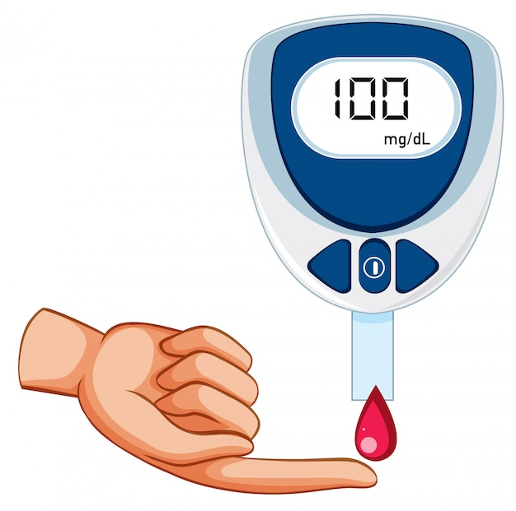
Blood Sugar Tracking
It is important that you follow your doctor’s suggestions. Always keep a logbook of your sugars and bring it to every appointment.
Checking your A1C completes the picture with your logbook to see how your sugars have been running for the last 3-months. This is important to see how they were running when you didn’t check, it gives an average.
Check your blood sugar when you feel symptoms. If you find yourself checking for symptoms more often, let your doctor know immediately and keep those results in your logbook to report them during the call or office visit.
Notes:
Check your glucose level as your doctor has requested. You need to also check your glucose level with a fingerstick and glucometer whenever you feel symptoms. Don’t rely on Continuous glucometers when feeling symptoms.

Slide 30
Blood Sugar Tracking
Always let your doctor know when you have a hypoglycemic or hyperglycemic episode. You need to treat or seek medical attention for these episodes immediately.
Notes:
We’ll go over symptoms and treatment a few slides from this one. The important thing to remember about symptoms and treatment is to always notify your doctor. If you have symptoms and treat or seek treatment, notify your doctor immediately after treating or discharge from the hospital.

Slide 31
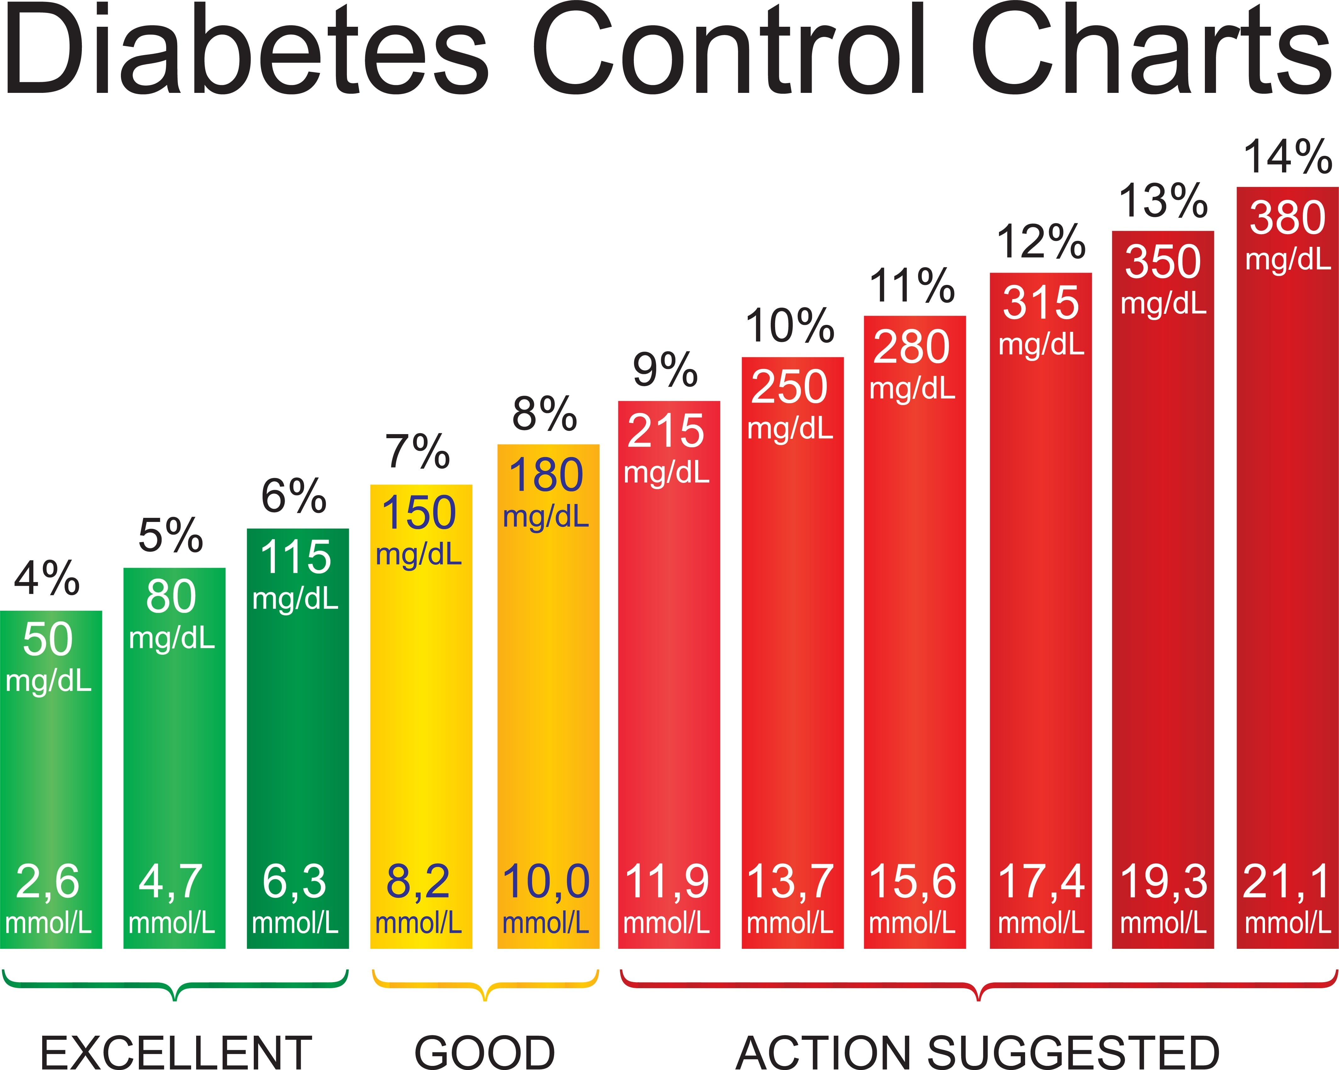
Blood Sugar Tracking
Always let your doctor know when you have a hypoglycemic or hyperglycemic episode. You need to treat or seek medical attention for these episodes immediately.
Blood sugar should be 80-130 before meals, up to 180 2 hours after your meal, then start coming back down.
Notes:
Glucose levels naturally start at a stable level, go up for about 2 hours after eating, then come back down to your stable glucose level 2 hours after that. The cycle of increasing glucose levels and coming back down to a stable level should be around 4 hours. This is for everyone, even for those without diabetes. Your “normal” or stable level is a personal number. Your doctor should be able to tell you what your “normal” or stable glucose level is because they know you on a personal level. Not everyone can be at the same stable glucose level because they feel symptoms. Some people are fine at 80 or 130, while others may feel symptoms at 80 and some may feel symptoms at 130. It all depends on how you as an individual feel at those levels. Generally, you should be somewhere between 80 and 130 before eating, 2 hours after be around 180 to 200, then go back down to 80 to 130 2 hours after that. Your doctor will tell you where they want your A1c level to be. The graph you see gives you an idea of what your average glucose level is at certain A1c levels.

Slide 32
Blood Sugar Tracking
Always let your doctor know when you have a hypoglycemic or hyperglycemic episode. You need to treat or seek medical attention for these episodes immediately.
Blood sugar should be 80-130 before meals, up to 180 2 hours after your meal, then start coming back down.
***See if you qualify for a continuous glucometer
Notes:
Continuous glucose monitors are great for day-to-day monitoring and can help you better manage your diabetes than finger sticks. Please check with your doctor to see if you qualify for continuous glucose monitors.

Slide 33
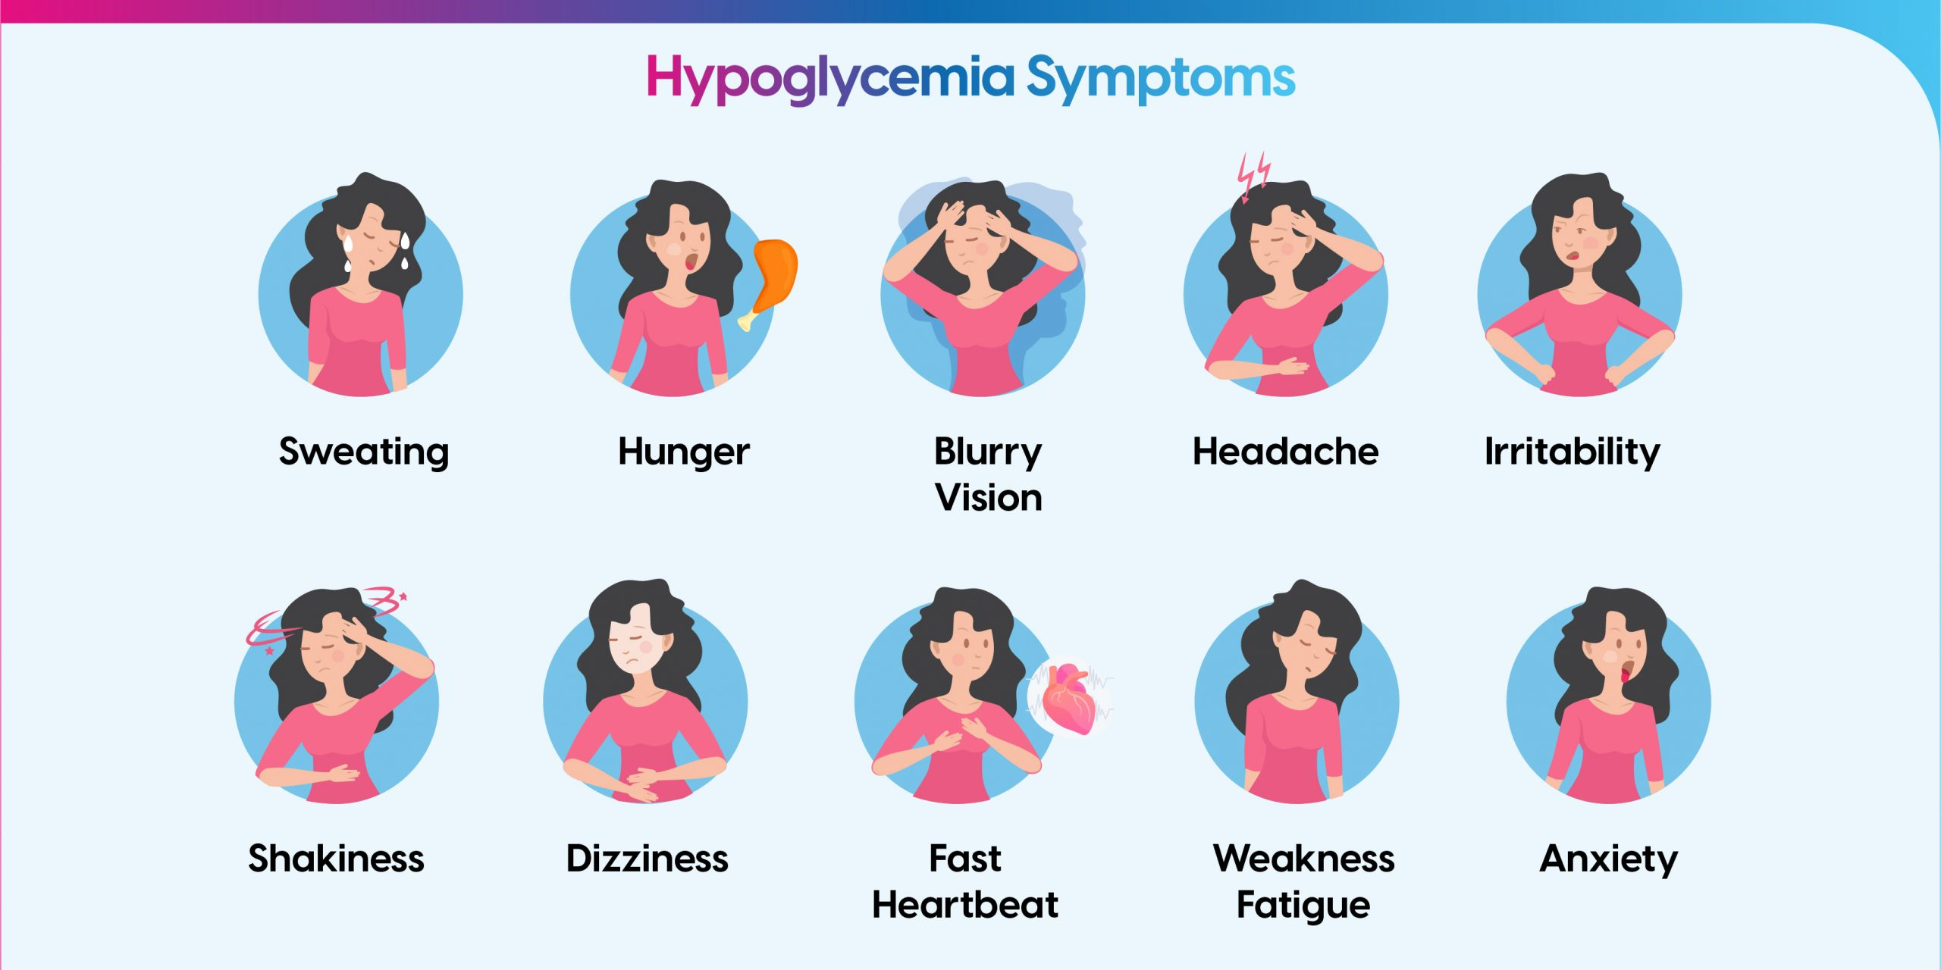
Notes:
Now we’ll discuss symptoms of Hypoglycemia, or low glucose levels. Some of these symptoms cross over into Hyperglycemia symptoms. Things to watch for are abnormal fatigue, irritability, confusion, shaking, trouble staying awake, fast heartrate, and sweating. Examples of severe Hypoglycemia would be extreme confusion, being non-responsive, and sweating and tired.

Slide 34
What to do?
Have something that is about 15 grams of carbs immediately only after checking your blood sugar level. Orange juice and Soda (4oz), glucose tablets, and hard candies are examples. Avoid things with protein when treating symptoms.
Wait 15 minutes and check your blood sugar again to make sure it’s coming up. If it isn’t improving, have another 15 carbs.
Call 911 or go to the emergency room immediately if have a severe episode of hypoglycemia, for any mild symptoms easily improved, call your doctor immediately.
Notes:
Because some of the symptoms of Hypoglycemia and Hyperglycemia are similar and needing to know what your exact glucose level, you need to check your glucose before treating. It’s important to get a glucose level via finger stick. Do not use your continuous glucose monitor in an emergency. It shows you your glucose level about 30 minutes ago and gives you an arrow to show where your glucose is heading (up, down, or staying the same). It’s not good to guess at a time when you need to treat symptoms. This goes for Hyperglycemia as well. If you check your glucose level and it’s low, eat 15 grams of simple carbohydrates. 4oz Orange juice, 4oz Soda, hard candies, glucose tabs, etc. DO NOT eat protein when treating low glucose levels. You only want carbohydrates. Remember, simple carbohydrates are easy to process. After eating 15 grams of carbohydrates, wait about 15 minutes and check your glucose level and symptoms. If your glucose is moving back to your stable level and you’re starting to feel better, wait another 30 minutes and check your glucose level again. If after eating 15 grams of carbohydrates you’re not feeling better and your glucose level isn’t improving, eat another 15 grams of carbs and check your glucose level in another 15 minutes. If you have had 30 grams of carbohydrates and you’re still not improving, go to the hospital. If you ever have a question about if you should go to the hospital, go to the hospital. ONLY TREAT SYMPTOMS WITH FOOD AND BEVERAGE IF YOU ARE SAFELY ABLE TO DO SO. DO NOT TRY TO TREAT WITH FOOD AND BEVERAGE IF YOU AREN’T ABLE TO SAFELY SWALLOW. IF YOU AREN’T ABLE TO STAY AWAKE OR YOU’RE TOO CONFUSED TO UNDERSTAND WHAT YOU’RE DOING, GO TO THE HOSPITAL.

Slide 35
Notes:
As said about hypoglycemia symptoms, some of the same symptoms cross over into Hyperglycemia. Symptoms like weakness and headache are seen with both low and high glucose levels.

Slide 36
What to do?
Follow the plan you and your doctor have discussed for high blood sugar, this may include a sliding scale.
If your blood sugar is higher than normal for 3 days with no reason and no symptoms, call your doctor to discuss this.
Call 911 or go to the emergency room immediately for any severe episode of hyperglycemia.
For mild episodes easily controlled with insulin while following you and your doctor’s plan, call your doctor immediately.
Notes:
Hyperglycemia treatment consists of using insulin. Insulin is the only treatment that can quickly bring down glucose levels. Talk to your doctor at your next visit about a plan to follow if you start to feel Hyperglycemia symptoms and at what level should you consider it an emergency. They may also give you a sliding scale with insulin to use in instances of high glucose levels. If you have higher than normal glucose levels with no symptoms for a few days consistently, call your doctor’s office and notify your doctor. If you have no plan and your doctor has not given you instructions on how to use insulin for these emergencies, go to the hospital. Again, if you question if you should go to the hospital, go to the hospital. DO NOT JUST START USING INSULIN WITHOUT TALKING TO YOUR DOCTOR. Your insulin you use every day may not be the right type and you could use a dangerous dose. Do not treat with insulin until you talk to your doctor.

Slide 37
Questions?
Thank you for attending today’s education. Please be sure to use this information as a guide along with the plan you and your doctor have discussed. There is no one-size fits all solution, regular follow ups with your doctor are key to track your progress.
Notes:
Thank you for your time today. I hope you learned something new from this presentation and are excited to manage your diabetes.

